Slide 1
What is a Computer System?

Slide 2
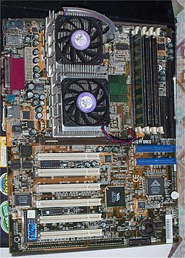

What is a computer system?
An accurate and fast data processing system.
Accepts, processes, and stores data.
Presents output.
Automatic device for performing complex tasks.
Breaks tasks into simple calculations.
Notes:
A computer system is an electronic machine that collects, store and manipulate information. Its operation is controlled by the instructions that are stored in its memory. The data manipulation is conducted through specified rules before producing the information as output. The components of the computer can either be hardware or software.
The word computer was derived from the word compute which imply calculate. The need for advanced arithmetic computations made it imperative to expand the functioning and design of the machine. In recent times computers have become diversified in functioning including design, multimedia processing, engineering design and communication.

Slide 3
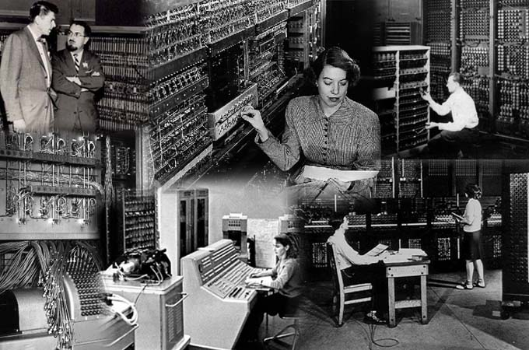
First Generation Computers
used vacuum tube technology.
Data input was through punched cards.
Output through punched cards and paper tape.
External storage was using magnetic tapes and drums.
Machine Language for writing programs.
Notes:
First-generation of computers occur between 1940 and 1950. The computers emitted high levels of heat and were bulky. It did not have any operating system. The machine language was long binary code for each computer. Some of the machines include Atanasoff-Berry Computer (ABC), ENIAC (Electronic Numeric Integrator and Calculator), EDVAC (Electronic Discrete Variable Automatic Computer), and UAC (Universal Automatic Computer).

Slide 4
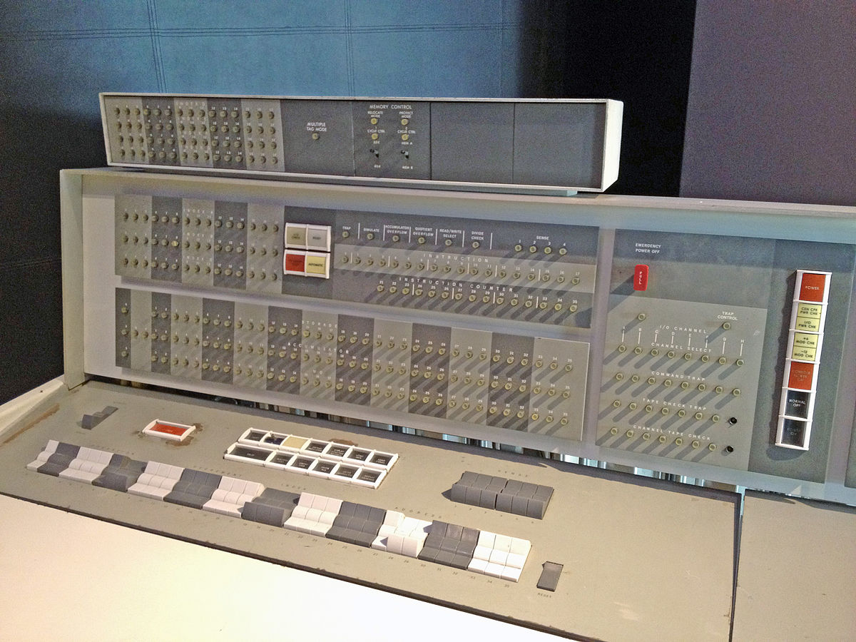
Second Generation Computers
Transistor technology.
Reduction in computer size.
Introduction of assembly language.
Emergence of stored programs.
Invention of high level languages.
Notes:
The second generation was notable for introducing the transistor. It was between 1956 and 1963. The vacuum tube in the first generation was replaced with the transistor. The transistor consists of silicon. It ensures that computers become smaller in size, emit lower heat resulting in lower cost. The computers become more reliable. The assembly language replaced the machine language resulting in the use of abbreviated programming code. The program stored were introduced to run the computer.

Slide 5
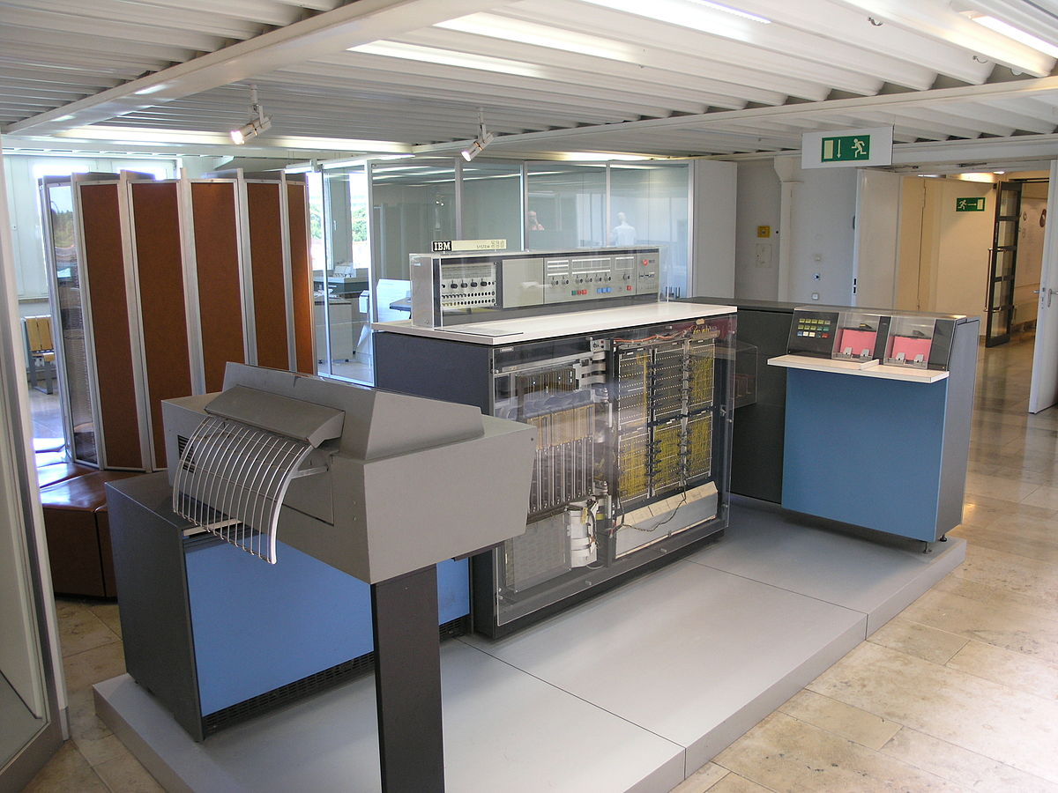
Third Generation Computers
Introduction of integrated circuits.
Computation speed rapidly increased.
Power consumption and size significantly reduced.
External storage through magnetic drums and tapes.
Operating systems design and innovation of new higher level languages.
Computers are produced for commercial production.
Notes:
The third generation of computers started between 1964 and 1971. It replaced the transistors with the Integrated Circuits (IC). IC consist of silicon (semiconductor material) and flat in size. IC integrated the many tiny transistors to form a small chip. Computers become smaller with lower heat emission. It makes computer cheaper with the introduction of Keyboards, Operating Systems and monitors. Computers became commercial because of the reduced cost. It enabled the use of higher languages such as COBOL, FORTRAN and Pascal.

Slide 6
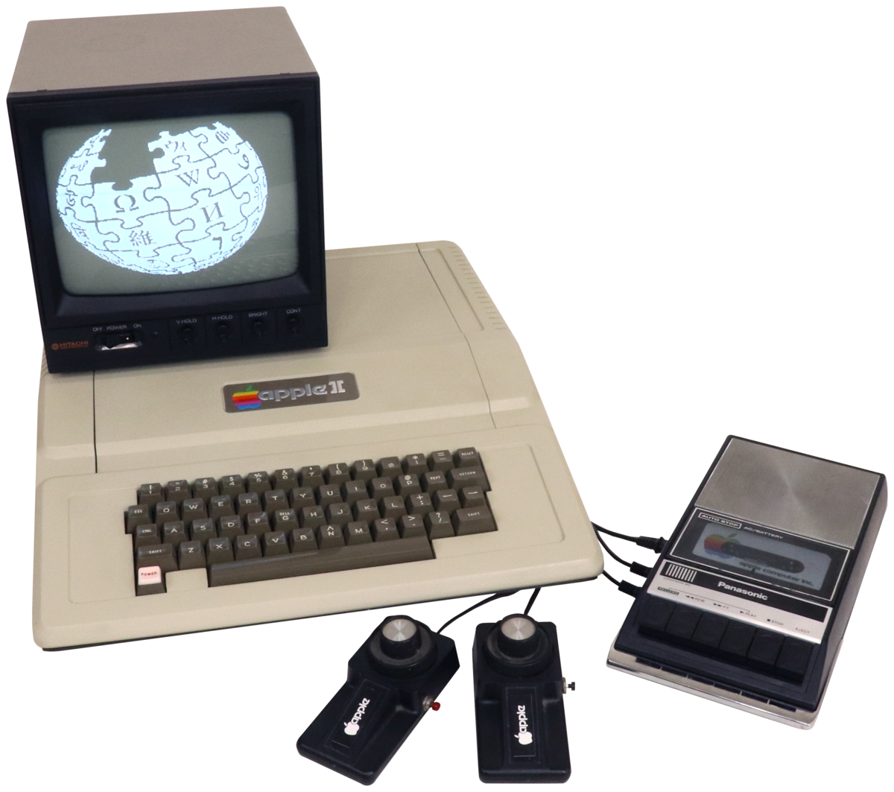
Fourth Generation Computers
Introduction of microcomputers.
introduction of Personal Computers.
RISE of NETWORKED computers.
More high-level programming languages.
Notes:
The fourth generation is between 1971-2000s. Processors deployed Large Scale Integration (LSI). ICs become expanded with thousands of transistors. It is where Personal Computer became prominent. High-level languages emerged including C++, C, Java and Visual Basic. The introduction of the internet and computer networking. Computers become reliable, portable and cheap.

Slide 7
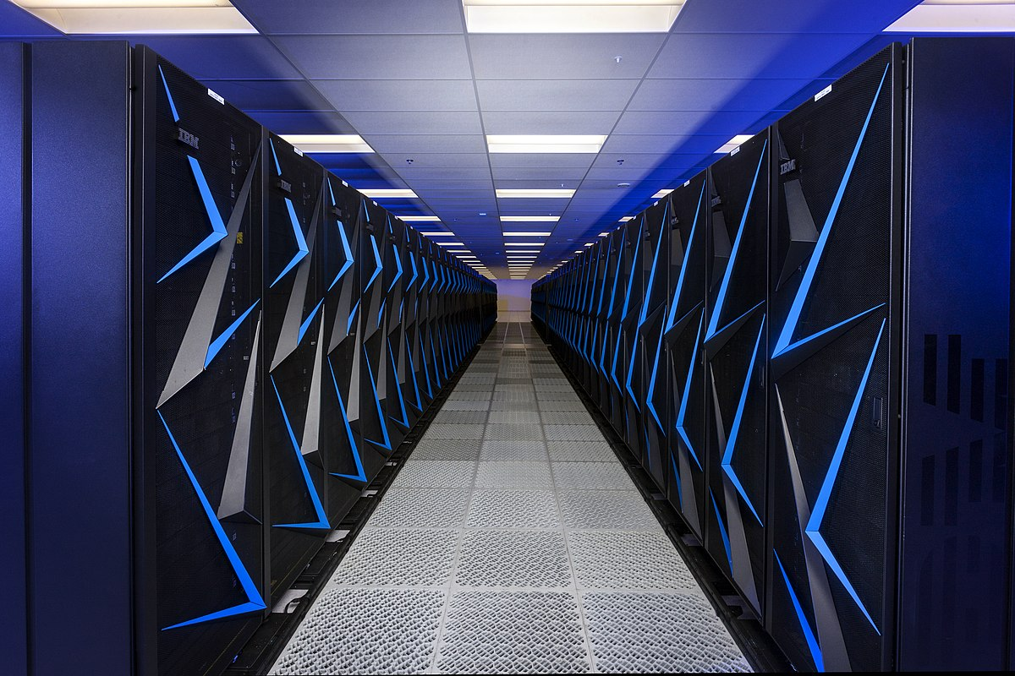
Fifth Generation Computers
Cheaper and MORE powerful computers.
Introduction of Ultra Large Scale Integration.
Superconductor technology.
INCREASED USE of Artificial Intelligence.
Advanced Processing such as Natural language processing, parallel processing.
Notes:
The fifth-generation is the current and future implementations of computing. Networking and computing have become sophisticated. The processor consists of Very Large Scale Integration (VLSI). Modern features include Artificial Intelligence, Quantum computing, and big data. The CPU introduces advanced superconductor technology and parallel processing. The processor is superfast with distributed computing.

Slide 8
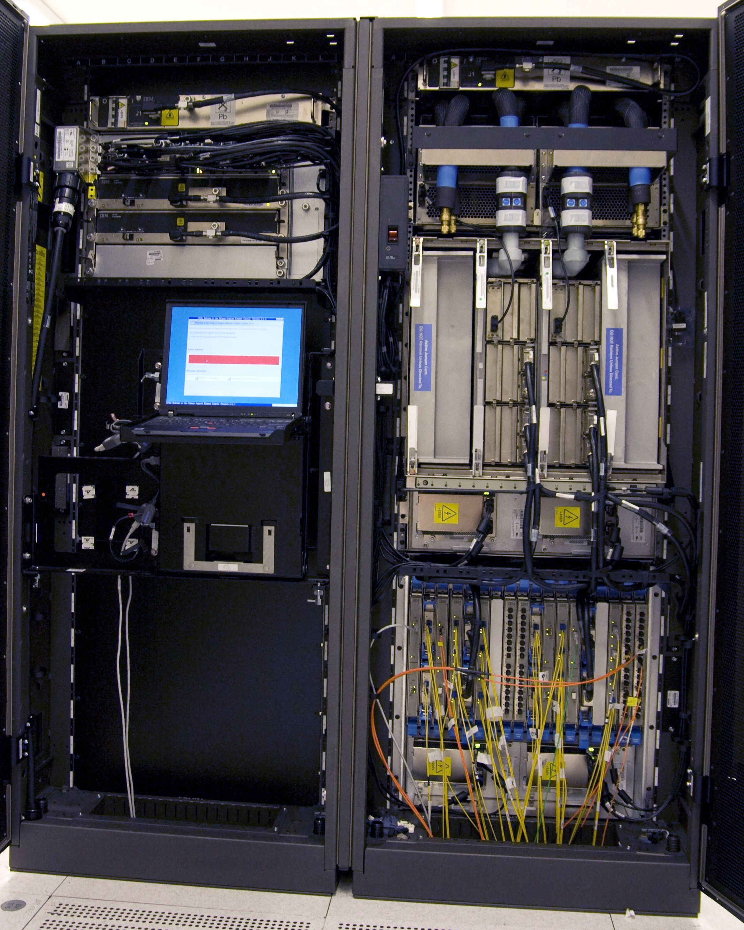
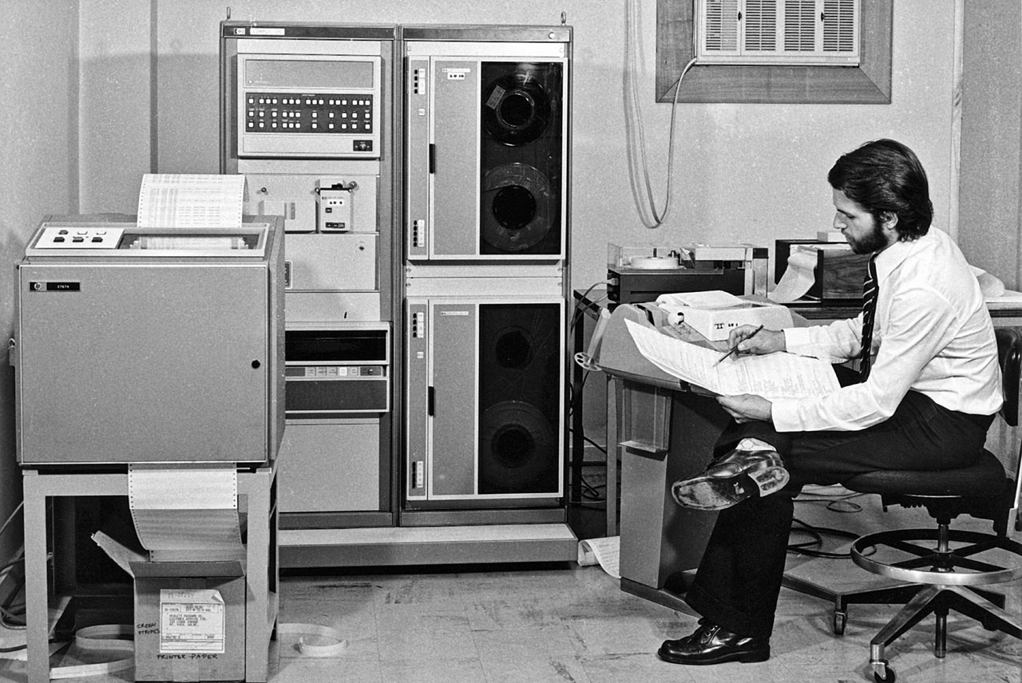
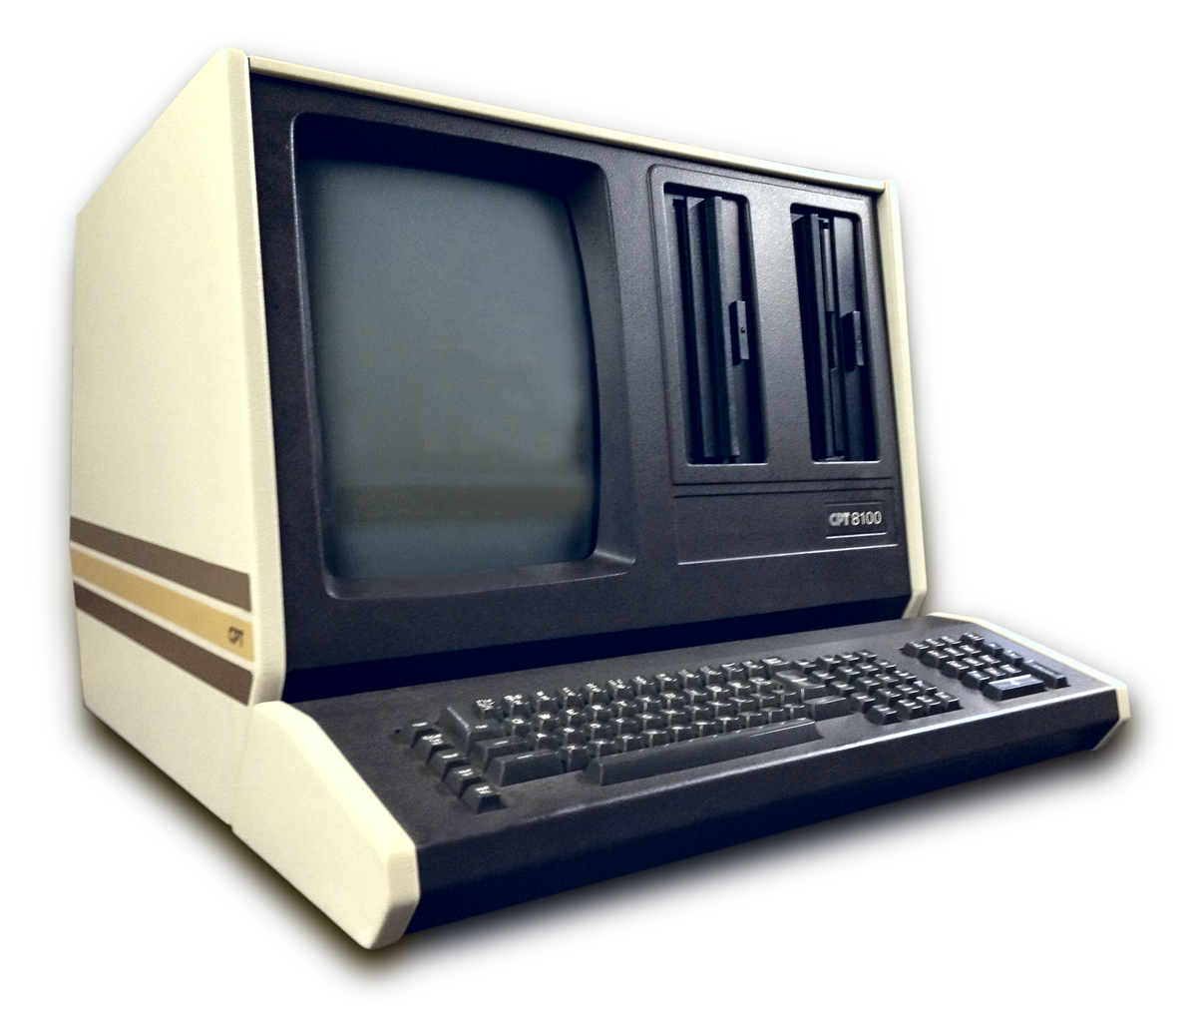
Types of Computer
Mainframe
Minicomputer
Microcomputer
Notes:
Mainframe Computer
Expensive and big in size
Support multi-user (thousands)
Often kept in a cool enclosed area
Mini Computer
More powerful and expensive than Micro computers
Support Multi-user
Support multi-processing
Computers are midrange
Micro Computers
Single User
Supports networking
central processing by microprocessor
Cheap and small sized
Examples of Micro Computers include desktop computer, smartphone, tablet, notebook, handheld computer.

Slide 9
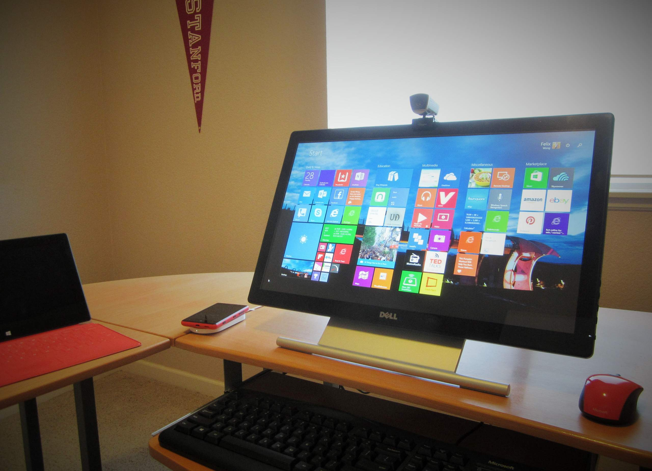
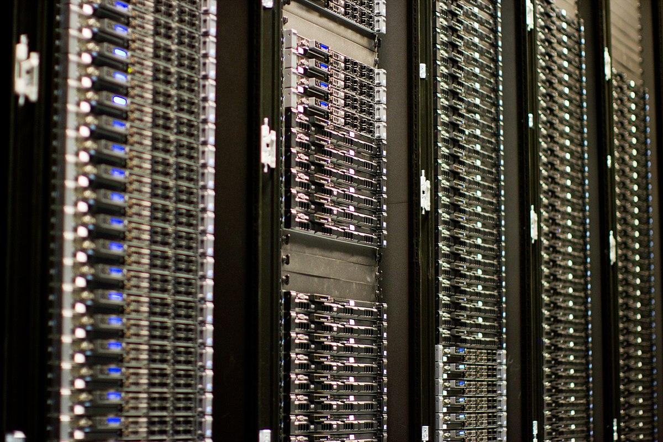
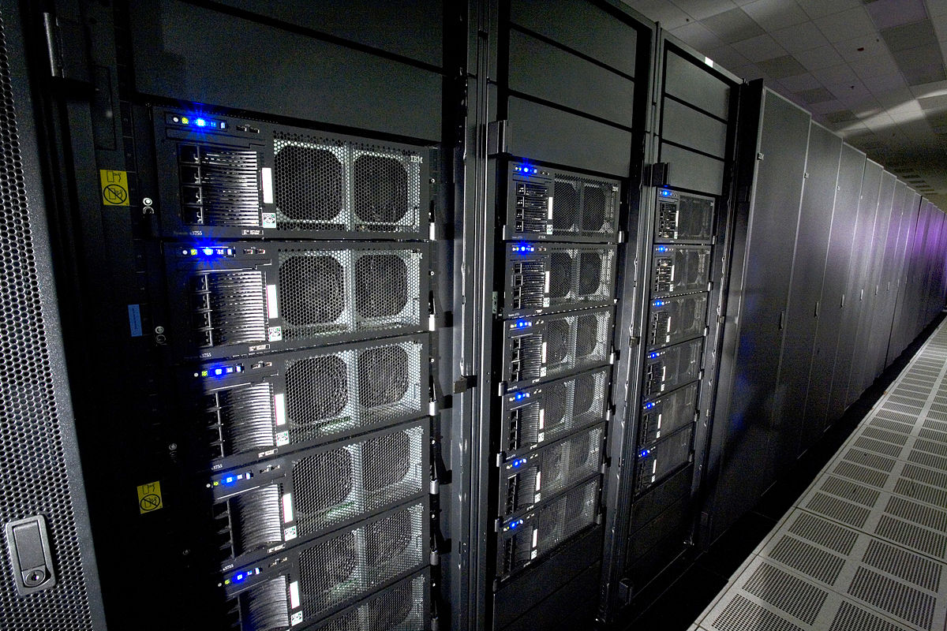
Types of Computer
Workstation
Server
Supercomputer
Notes:
Workstations
Big sized RAM
Moderate computing power
Single user through Local Area Network
High resolution graphics screen
Workstation are used for team projects like publishing, software development and engineering design.
Server
Runs backend services
Serves web pages
Infrastructure
Servers are the backbone of modern computing.
Super Computer
Specialist usage oriented
Size is very big
It is highly expensive
The fastest available computer
Super computers are used for high computing processes such as weather forecasting, Artificial Intelligence, and launching satellite.

Slide 10
In Summary:
A computer system is a data processing system.
We are currently in the fifth generation of computing.
Computers can be broken down into different types.
Original Slides by Pelumi Apantaku
Updated Slides by Kevin Chalmers
Video by Kevin Chalmers
Images courtesy of Wikimedia

